Slide 1
Vector Databases
for
Semantic Search
Onisie Andreea
BDNSV Final Project - Year III 2025-2026, gr. 342

Slide 2
Main idea
This project presents an overview of vector databases and their role in enabling semantic search over unstructured data. It explains how embeddings allow systems to capture meaning and perform similarity search, supporting applications such as search engines and recommendation systems. The report also covers key indexing techniques and shows how modern vector databases balance accuracy, speed, and memory efficiency.
In addition, the project focuses on the integration of vector databases into AI pipelines, particularly in combination with large language models through retrieval-augmented generation (RAG). Recent trends such as semantic compression, graph-augmented retrieval, hybrid search, and multimodal embeddings are highlighted, showing how these approaches improve performance and support multiple data types.
Finally, future research directions are outlined, including self-updating indexes, hardware acceleration, and scalable architectures. Overall, vector databases are presented as a core component of modern AI systems, enabling efficient and meaningful use of large-scale unstructured data.

Slide 3
Demo Semantic Compression
Inspired by the ideas presented in the “Beyond Nearest Neighbors” article, I also implemented a small-scale semantic search system using open-source tools.
Text data is loaded from a .csv file (AG News dataset from Kaggle). Sentence embeddings are generated using the pretrained all-MiniLM-L6-v2 model from HuggingFace (384 dimensions). Embeddings are then compressed using PCA to lower dimensions (64D and 32D) while preserving semantic information. Semantic search is performed on full embeddings and compressed embeddings for comparison.
This experiment aims to show that compressed embeddings can still support meaningful semantic search while reducing vector size and improving efficiency.
Video with demo for semantic compression available HERE.
Code for demo implementation available HERE.

Slide 4
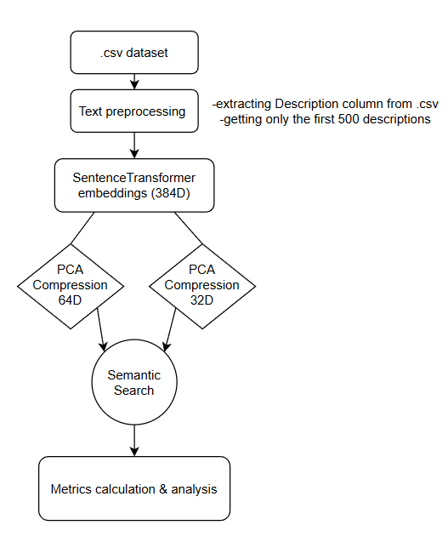
Demo Flow & Implementation Details
Dataset:
AG News dataset from Kaggle (first 500 documents used in demo), access it here.
Columns used from dataset:
Description (text)
Embedding representation:
384D full embeddings, 64D and 32D compressed embeddings (compressed using model all-MiniLM-L6-v2)
Architecture

Slide 5
Research Key Ideas
Embeddings turn text (or images/audio) into numerical vectors.
Similarity is measured using different distance metrics.
Embeddings enable semantic search: they find items with the same meaning, even if the wording differs.
Embeddings are nowadays the key for search engines, recommendation systems and AI assistants.
Keyword search fails to capture meaning or context.
Semantic search uses embeddings to compare meaning, not only words.
Vector databases store high-dimensional embeddings efficiently and allow fast and scalable similarity search.

Slide 6
There are several indexing techniques, such as:
Distance-based: simple brute-force, slow for large datasets.
Partition-based: groups similar vectors into clusters.
Graph-based: connects nearest neighbors, search navigates promising paths.
Compression-based: reduces vector size for memory and speed efficiency.
Hybrid methods combine techniques for speed + accuracy.
There are several trends & applications, such as:
Semantic compression: smaller vectors with little loss in search quality.
Multimodal embeddings: combine text, images, audio in one space.
Integration with AI/LLMs: retrieval-augmented generation (RAG).
Future directions: self-updating indexes, hardware acceleration, scalable search.
Applications in search engines, recommendation systems, AI assistants, scientific data analysis.

Slide 7
Research conclusions
This research explored the vector databases for semantic search, showing how these systems have changed the way we store, retrieve, and use unstructured data. We started by understanding why keyword search is no longer enough, and after that we learned how vector databases work. We looked at how embeddings work, how they allow semantic search, and how vector databases use them to find similarities and make recommendations.
Indexing techniques were explained in detail, showing how modern systems balance accuracy, speed, and memory usage.
Modern vector databases are more than just storage, because they are integrated into AI pipelines, especially when working with large language models (LLMs). With this topic on, we also discussed retrieval-augmented generation (RAG).
The report also looked at trends and advanced techniques, such as semantic compression, graph-augmented retrieval, multimodal embeddings and hybrid search. These innovations help vector databases work faster, use less memory, and support multiple types of data, including text, images, and audio. We saw that compression can reduce storage needs while keeping results as accurate as possible, and we also saw that multimodal embeddings allow the system to link information from different sources at the same time.
Finally, we considered future directions for vector databases. Research is focusing on self-updating indexes, hardware acceleration, distributed and scalable architectures and adaptive search methods. These improvements will make vector databases even more efficient, intelligent, and integrated with AI applications.
In short, vector databases are becoming essential for modern AI systems, providing the tools needed to handle unstructured data in a meaningful, practical, and scalable way.

Slide 8
Demo conclusions & interpretations
Semantic Compression
Semantic compression makes search much faster and uses less memory while keeping most of the important information. In these three examples, moving from full embeddings to 64 dimensions kept recall high, and even at 32 dimensions the results were still reasonable. Overall, compressing embeddings is a great trade-off: you get huge speed and memory improvements with only a small drop in accuracy.
See examples and interpretations HERE.

Slide 9
References
[1] James Jie Pan, Jianguo Wang & Guoliang Li, Survey of Vector Database Management Systems, 2023, https://arxiv.org/pdf/2310.14021, Last accessed: January 2026
[2] Cuzzocrea Alfredo, Vector Databases for Modelling, Managing and Querying Big Scientific Data: Models, Issues, Paradigms, 2025, https://dl.acm.org/doi/pdf/10.1145/3733723.3742469, Last accessed: January 2026
[3] Rahul Raja & Arpita Vats, Beyond Nearest Neighbors: Semantic Compression and Graph-Augmented Retrieval for Enhanced Vector Search, 2025, https://arxiv.org/pdf/2507.19715, Last accessed: January 2026
[4] OpenAI, ChatGPT, https://chatgpt.com/, Last accessed: January 2026
[5] Kaggle, AG News Classification Dataset, https://www.kaggle.com/datasets/amananandrai/ag-news-classification-dataset?resource=download, Last accessed: January 2026
[6] Hugging Face, sentence-transformers/all-MiniLM-L6-v2, https://huggingface.co/sentence-transformers/all-MiniLM-L6-v2, Last accessed: January 2026

Slide 10
Thank you!
For more about the project, access GitHub HERE.

